Slide 1
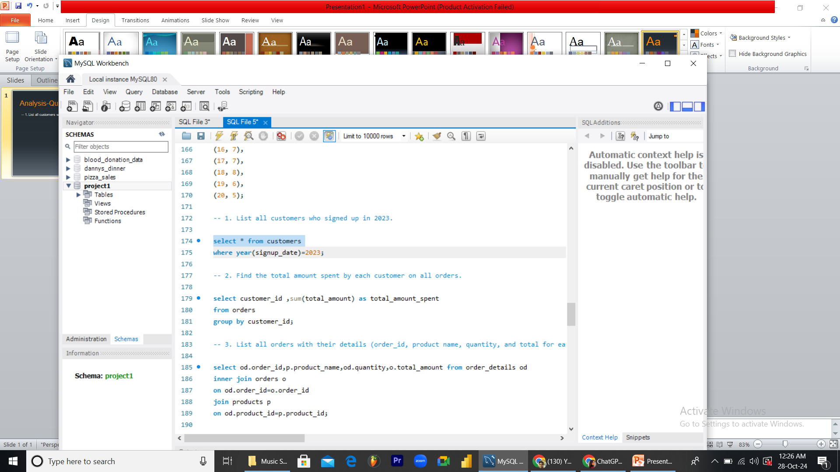
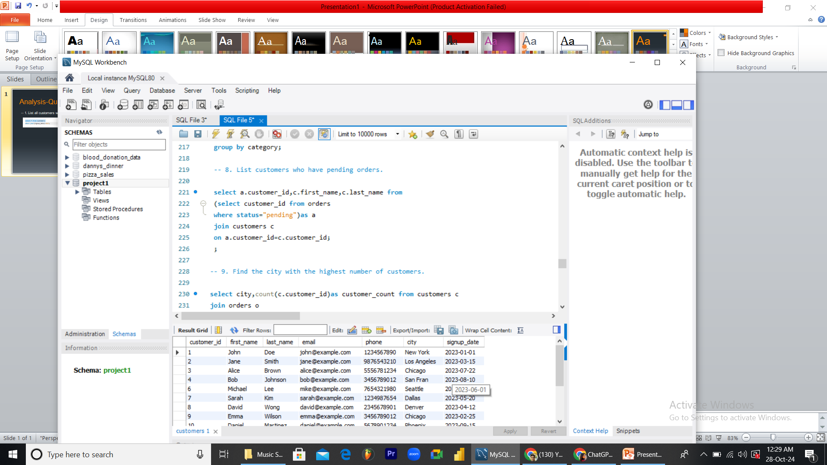
Analysis-Questions Answer
-- 1. List all customers who signed up in 2023.

Slide 2
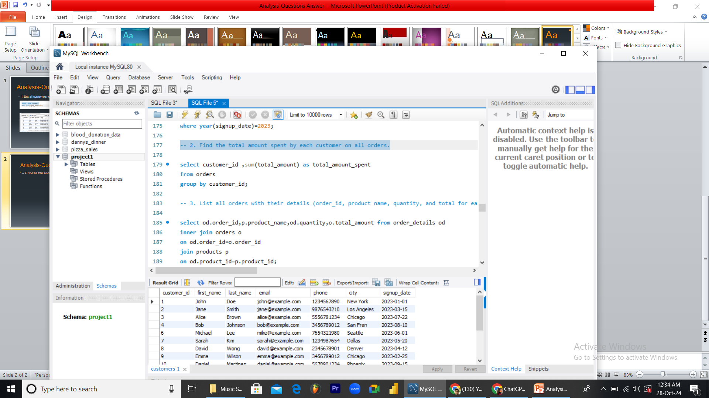
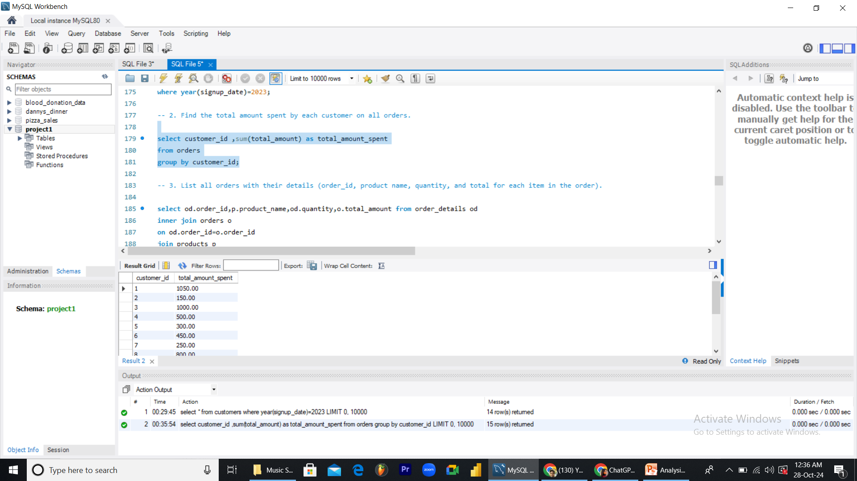
Analysis-Questions Answer
-- 2. Find the total amount spent by each customer on all orders.

Slide 3
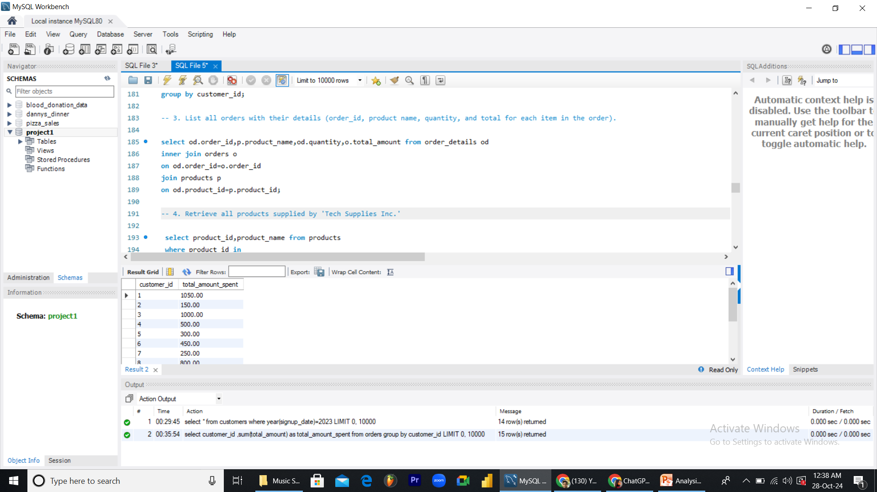
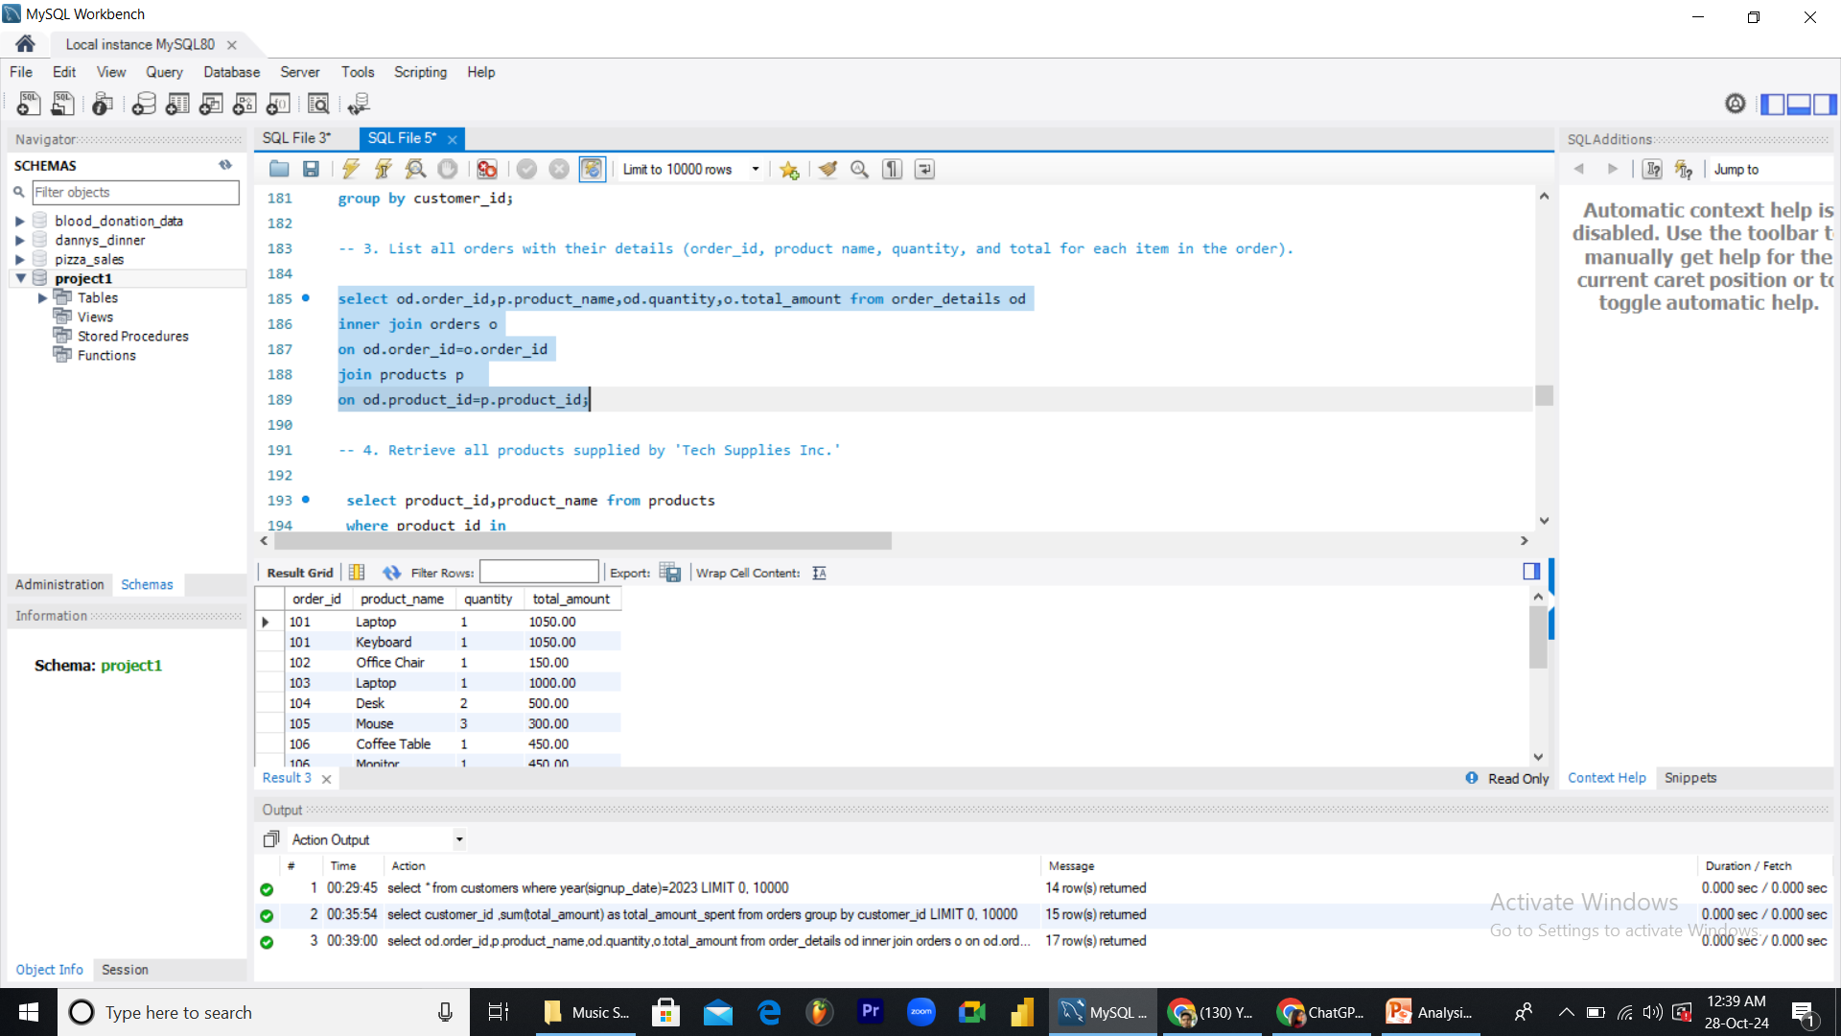
Analysis-Questions Answer
-- 3. List all orders with their details (order_id, product name, quantity, and total for each item in the order).

Slide 4
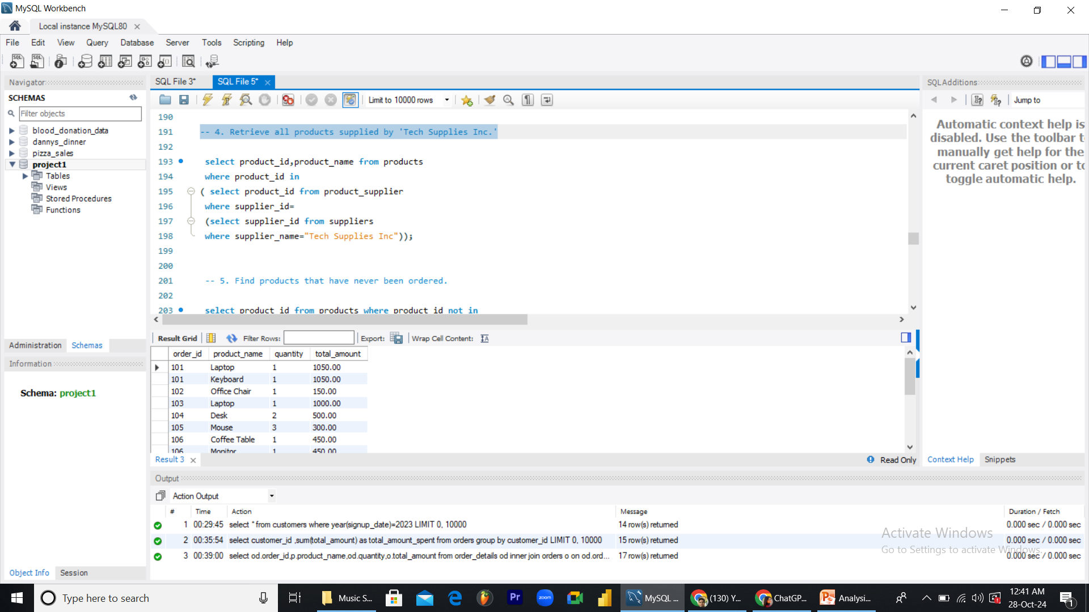
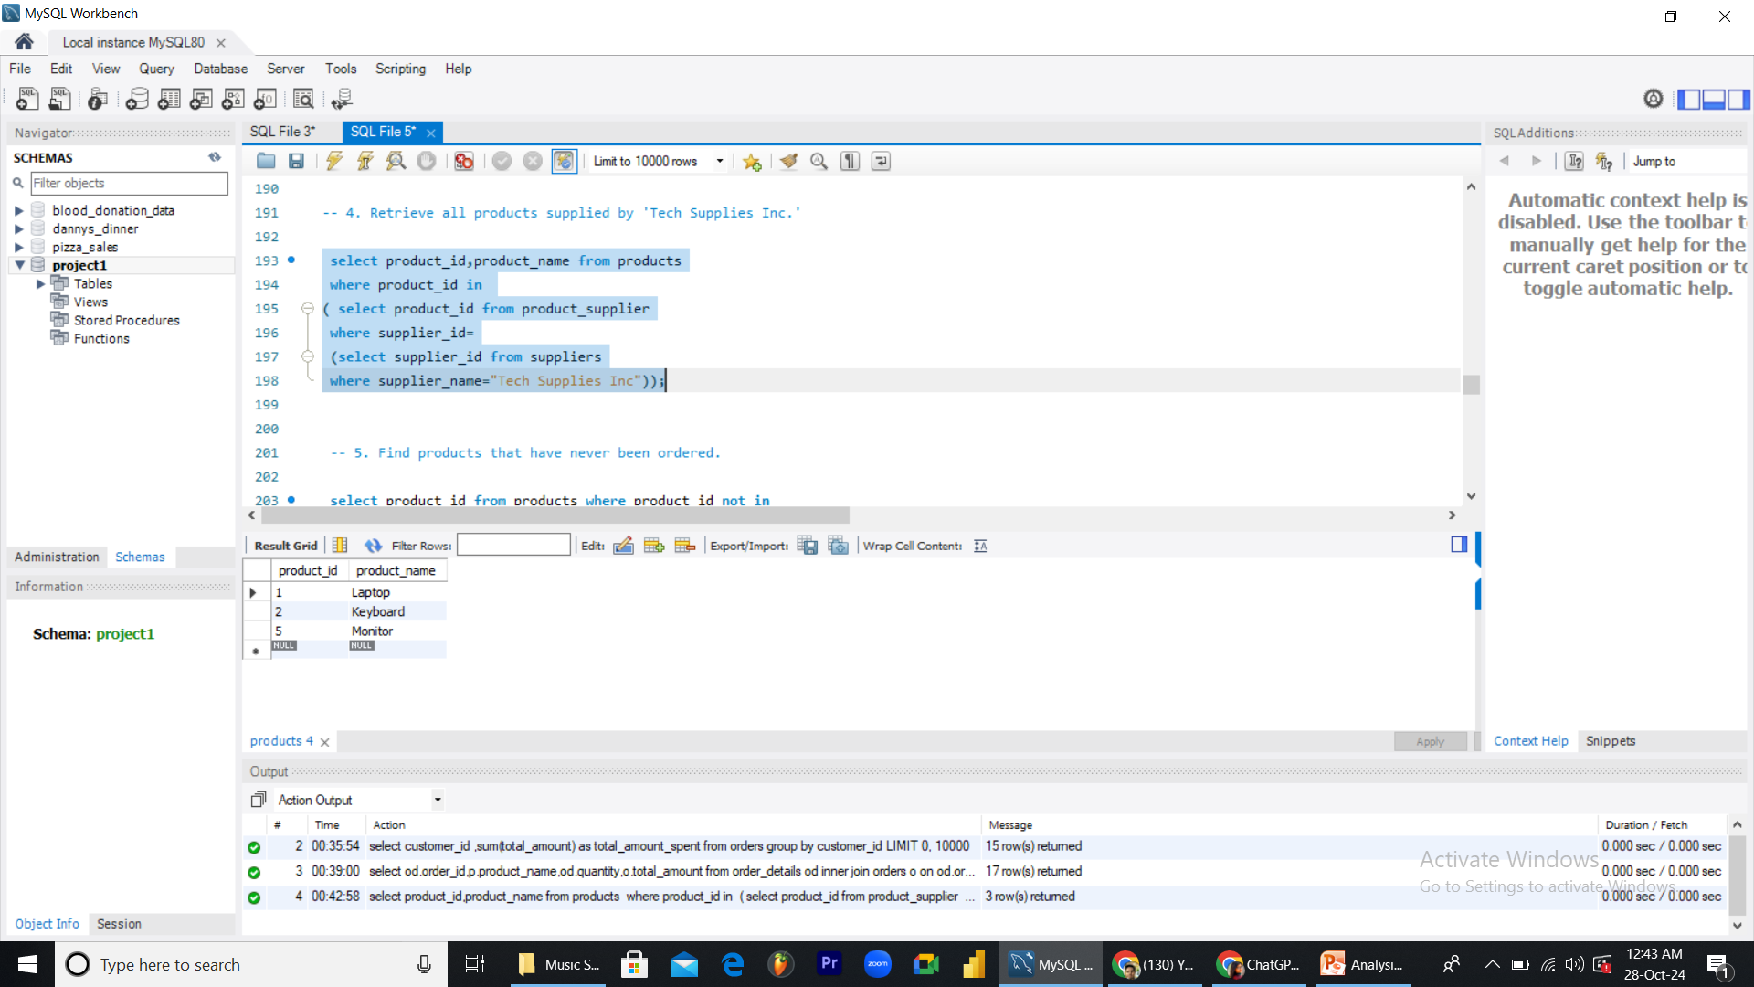
Analysis-Questions Answer
-- 4. Retrieve all products supplied by 'Tech Supplies Inc.'

Slide 5
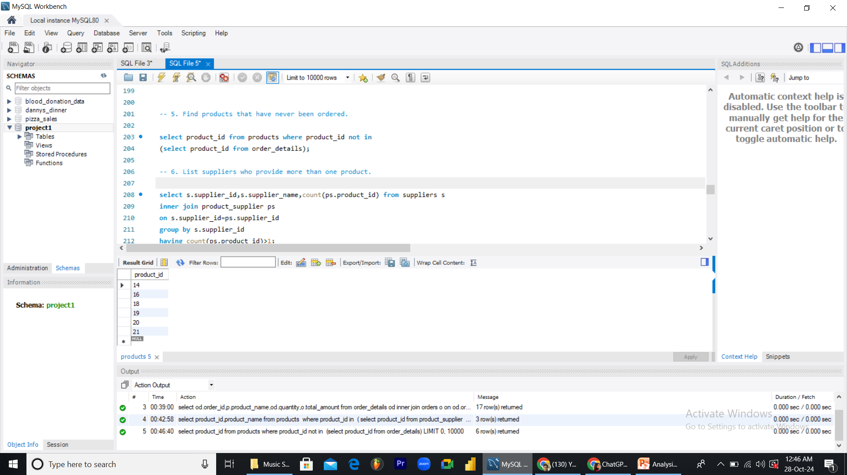

Analysis-Questions Answer
-- 5. Find products that have never been ordered.

Slide 6
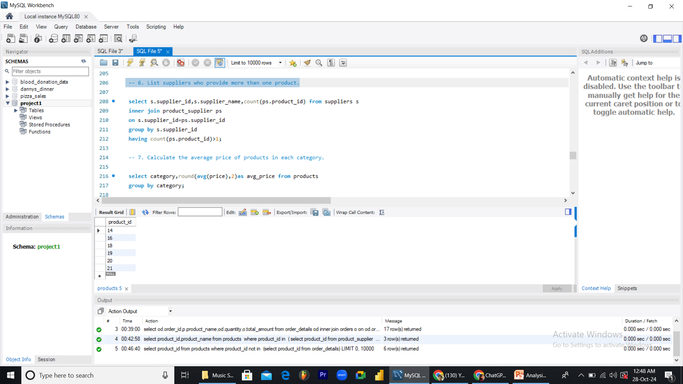
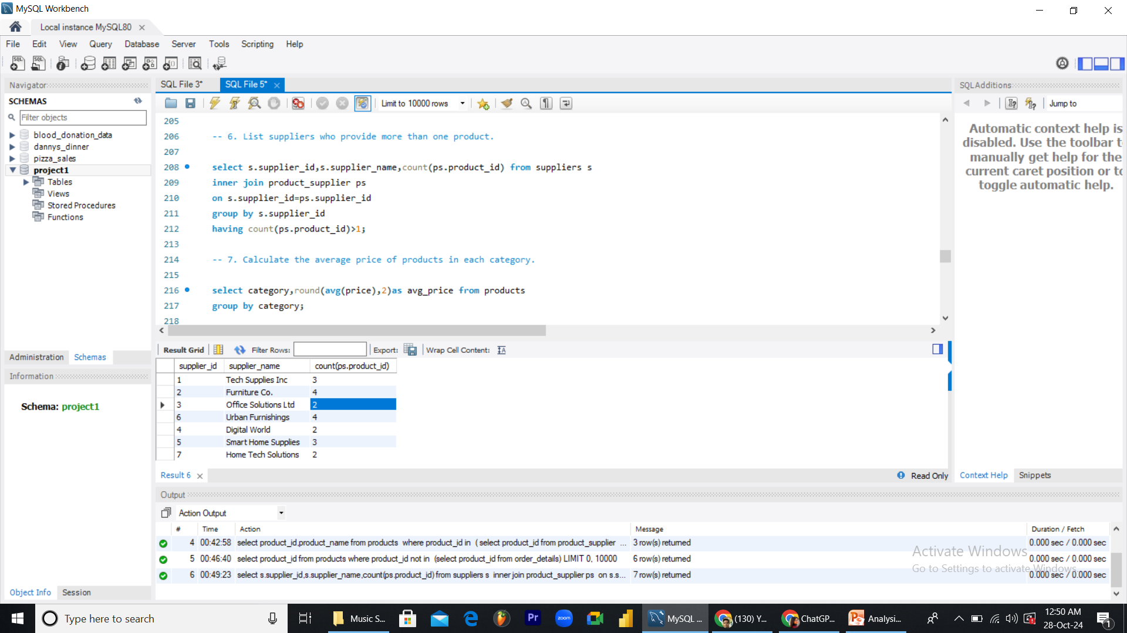
Analysis-Questions Answer
-- 6. List suppliers who provide more than one product.

Slide 7
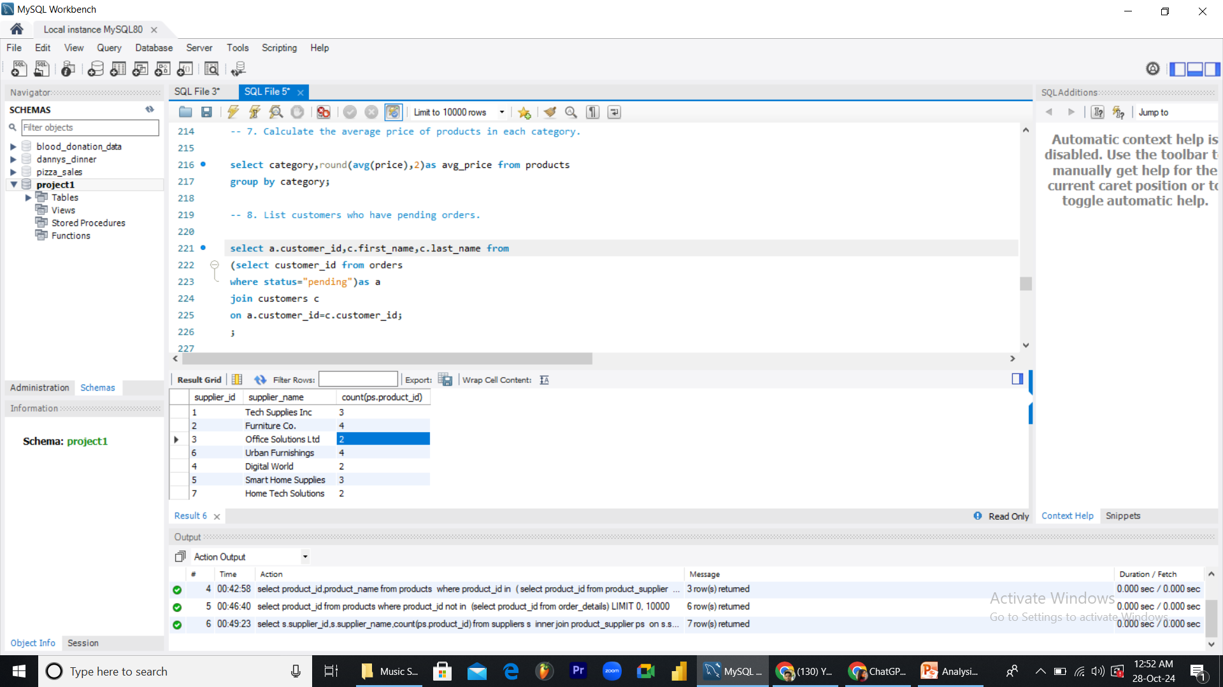
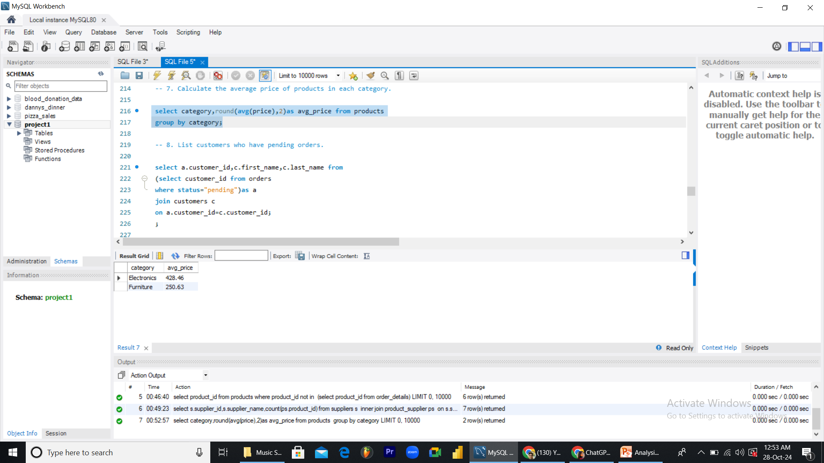
Analysis-Questions Answer
-- 7. Calculate the average price of products in each category.

Slide 8

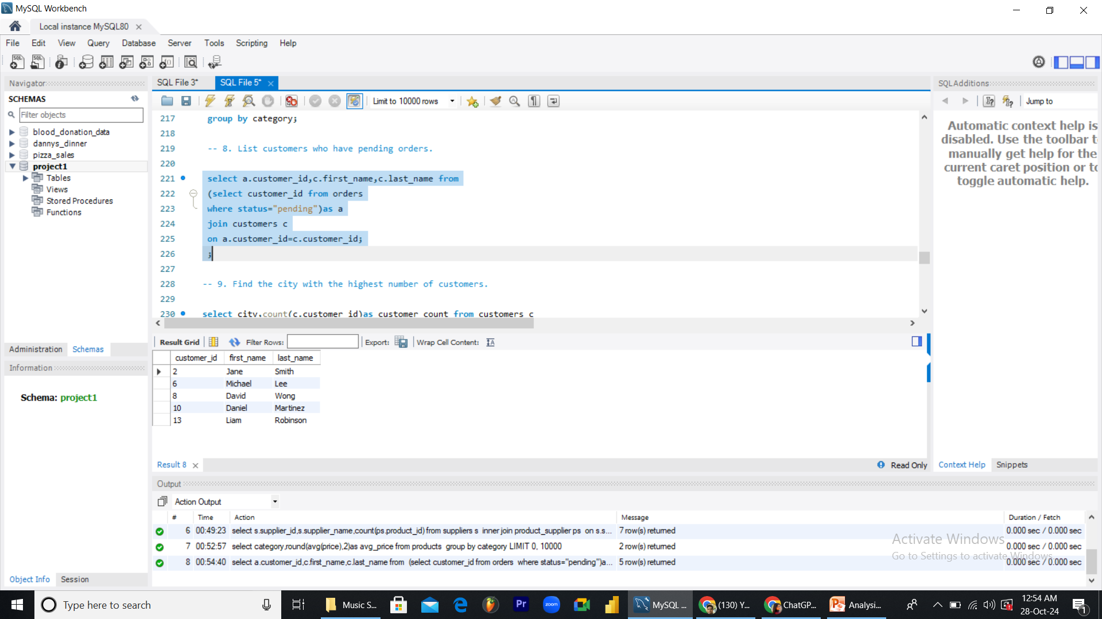
Analysis-Questions Answer
-- 8. List customers who have pending orders.

Slide 9
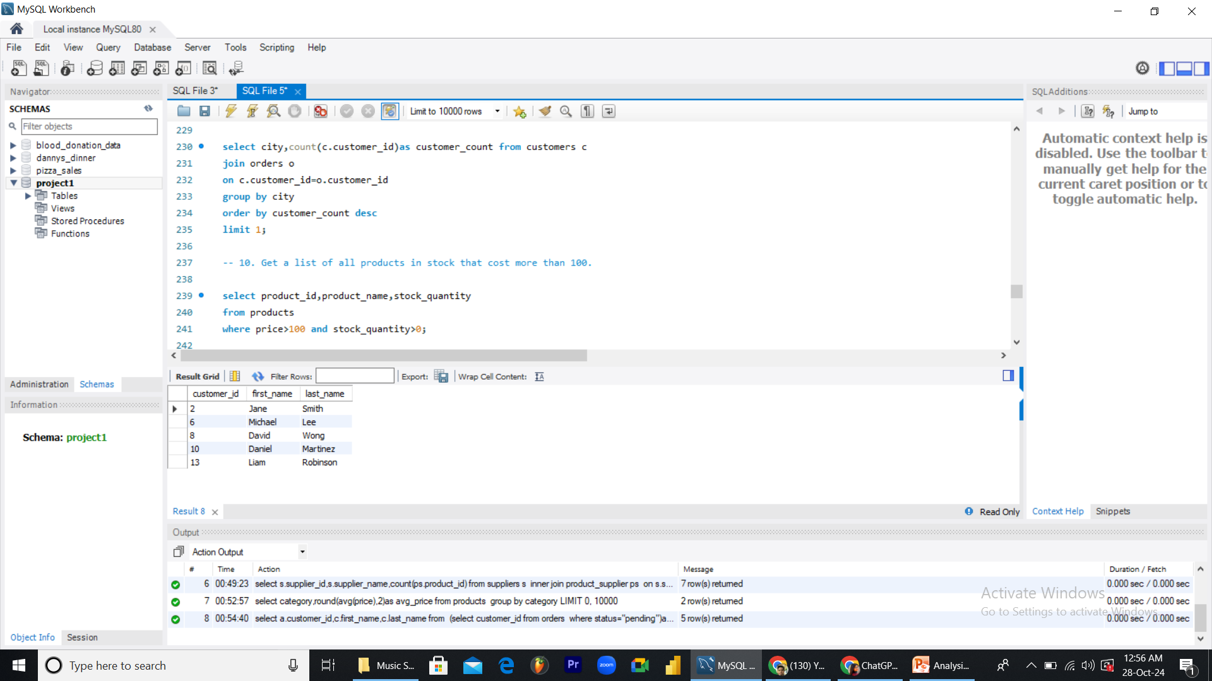

Analysis-Questions Answer
-- 9. Find the city with the highest number of customers.

Slide 10

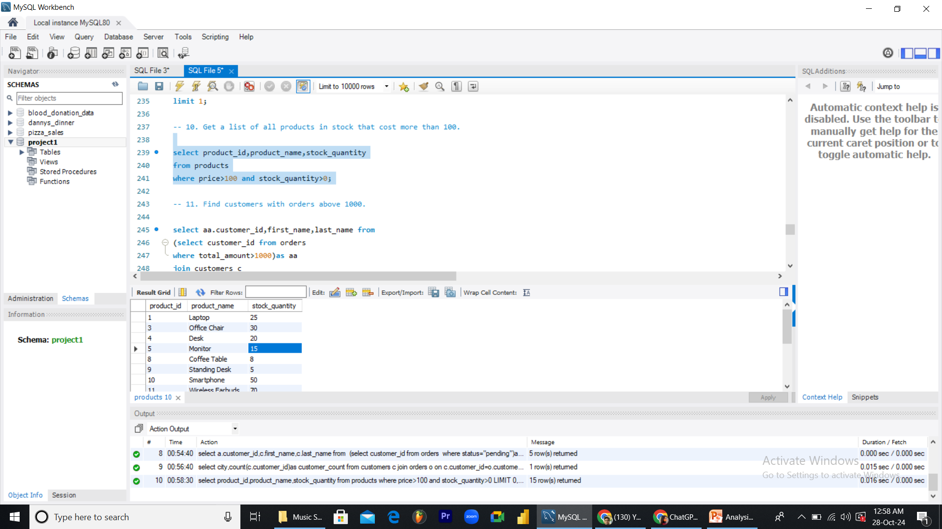
Analysis-Questions Answer
-- 10. Get a list of all products in stock that cost more than 100.

Slide 11
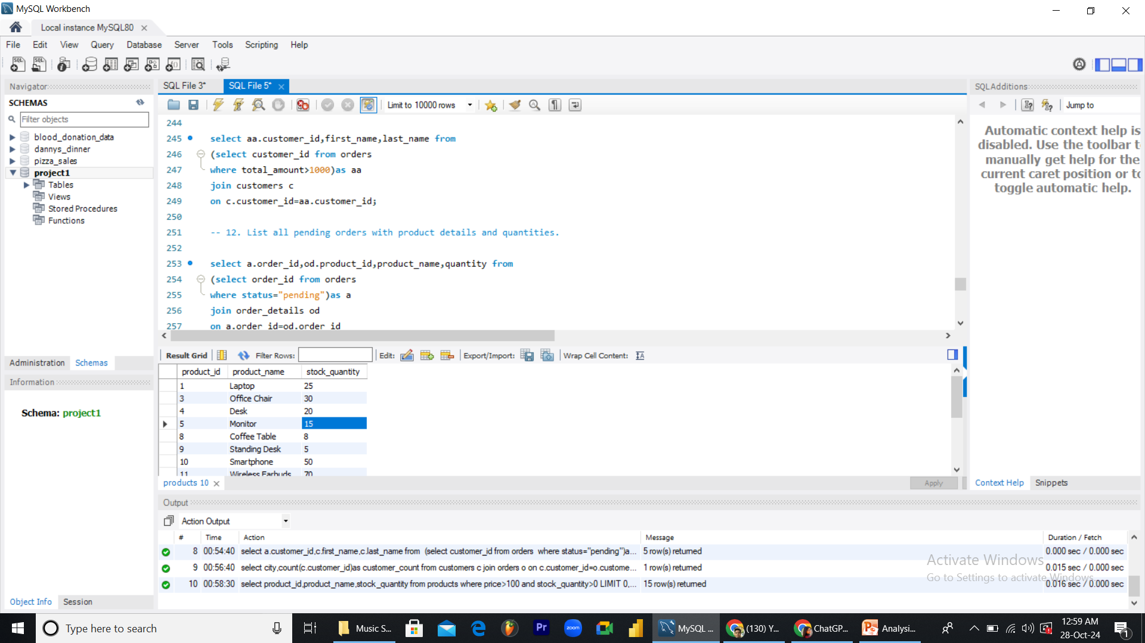
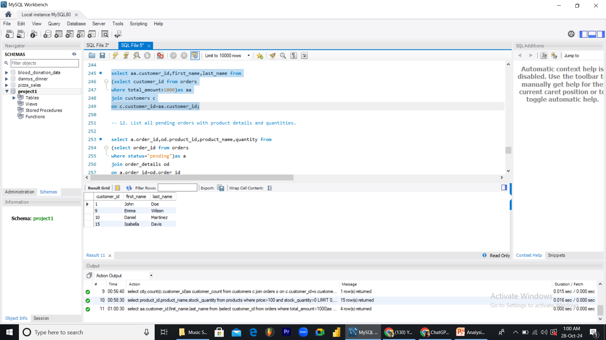
Analysis-Questions Answer
-- 11. Find customers with orders above 1000.

Slide 12
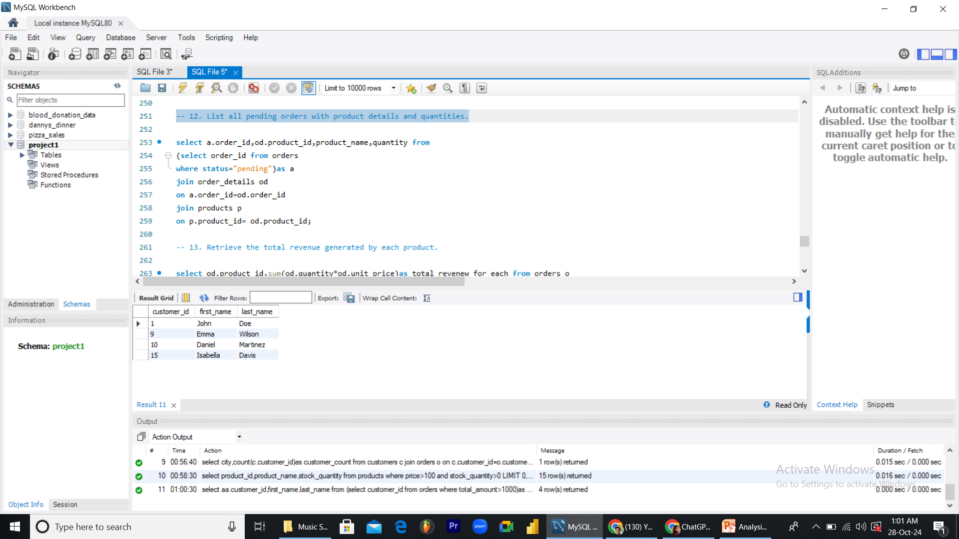
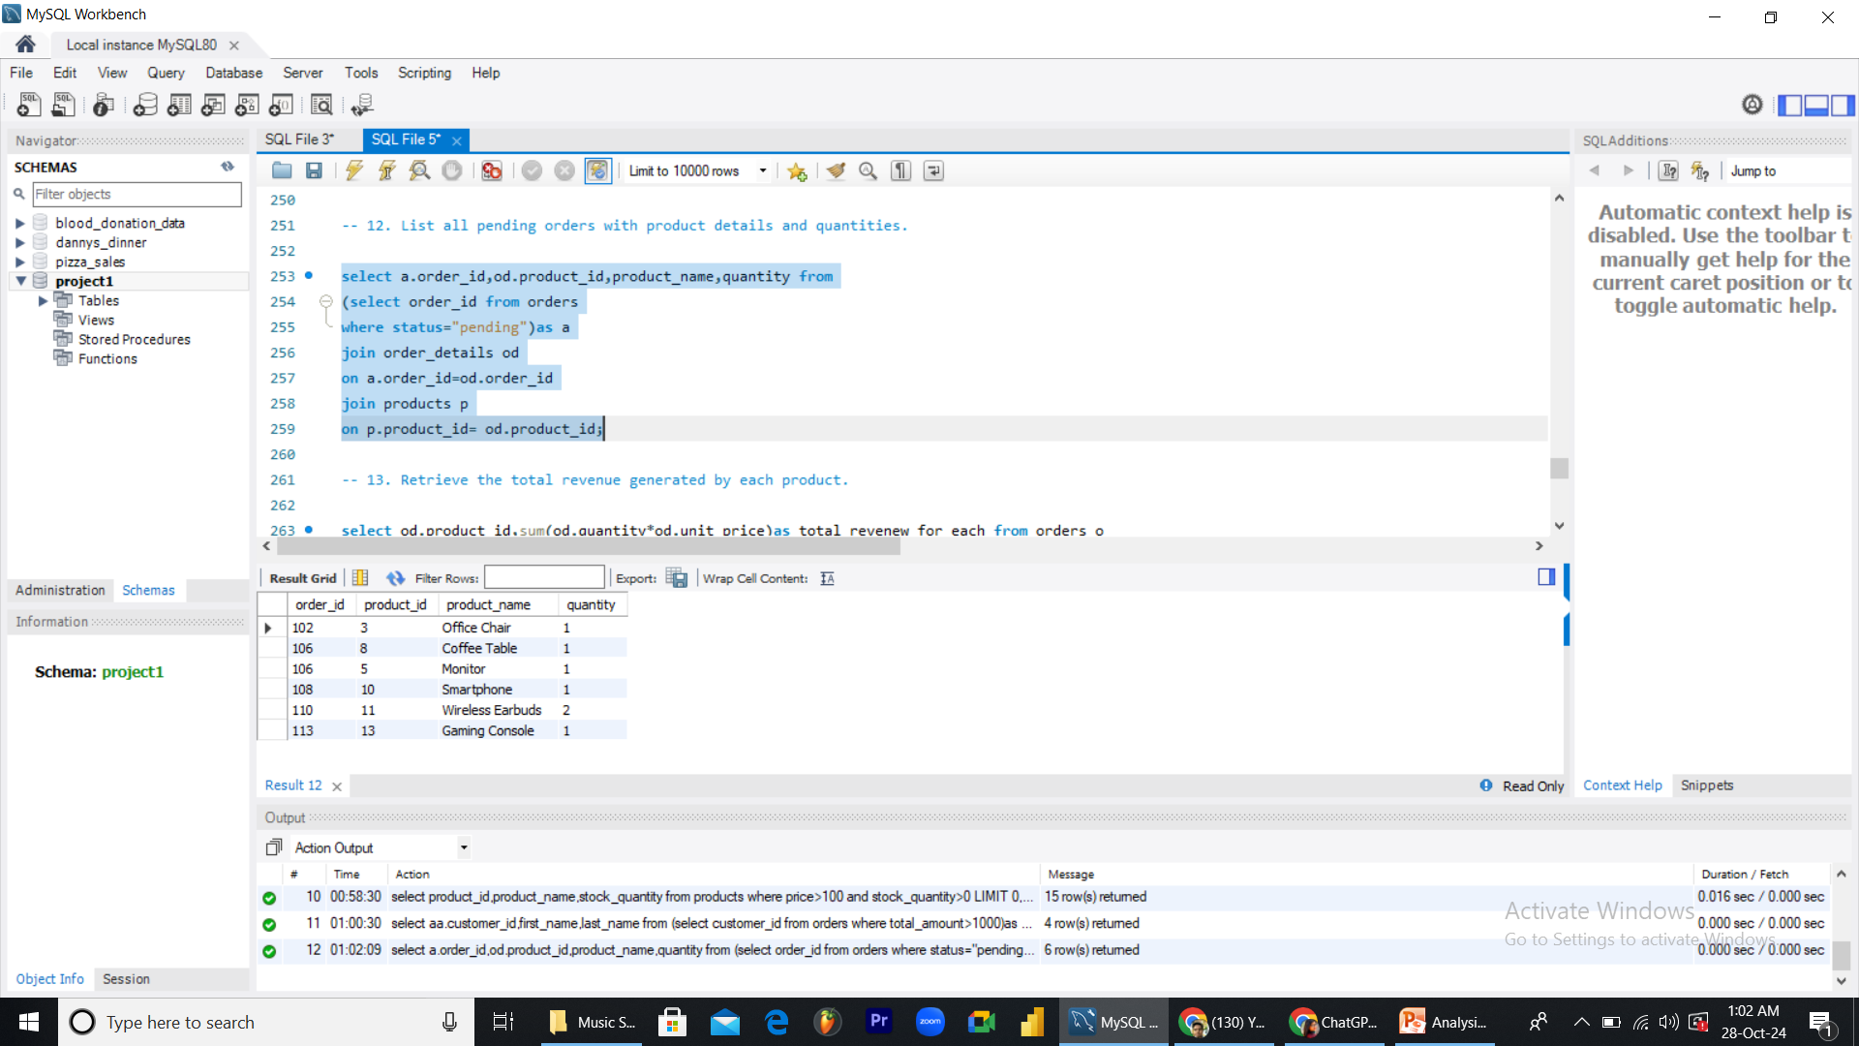
Analysis-Questions Answer
-- 12. List all pending orders with product details and quantities.

Slide 13
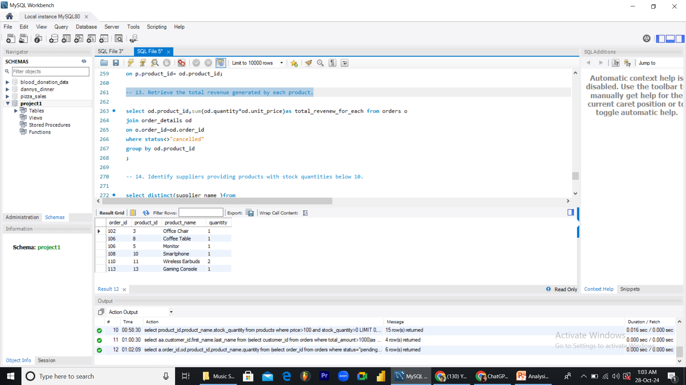
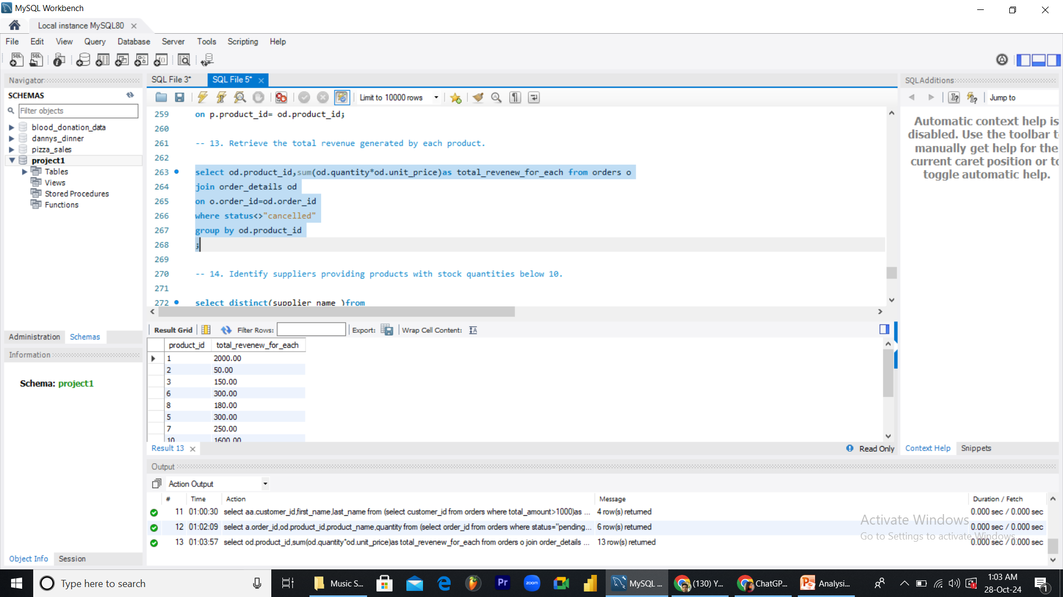
Analysis-Questions Answer
-- 13. Retrieve the total revenue generated by each product.

Slide 14
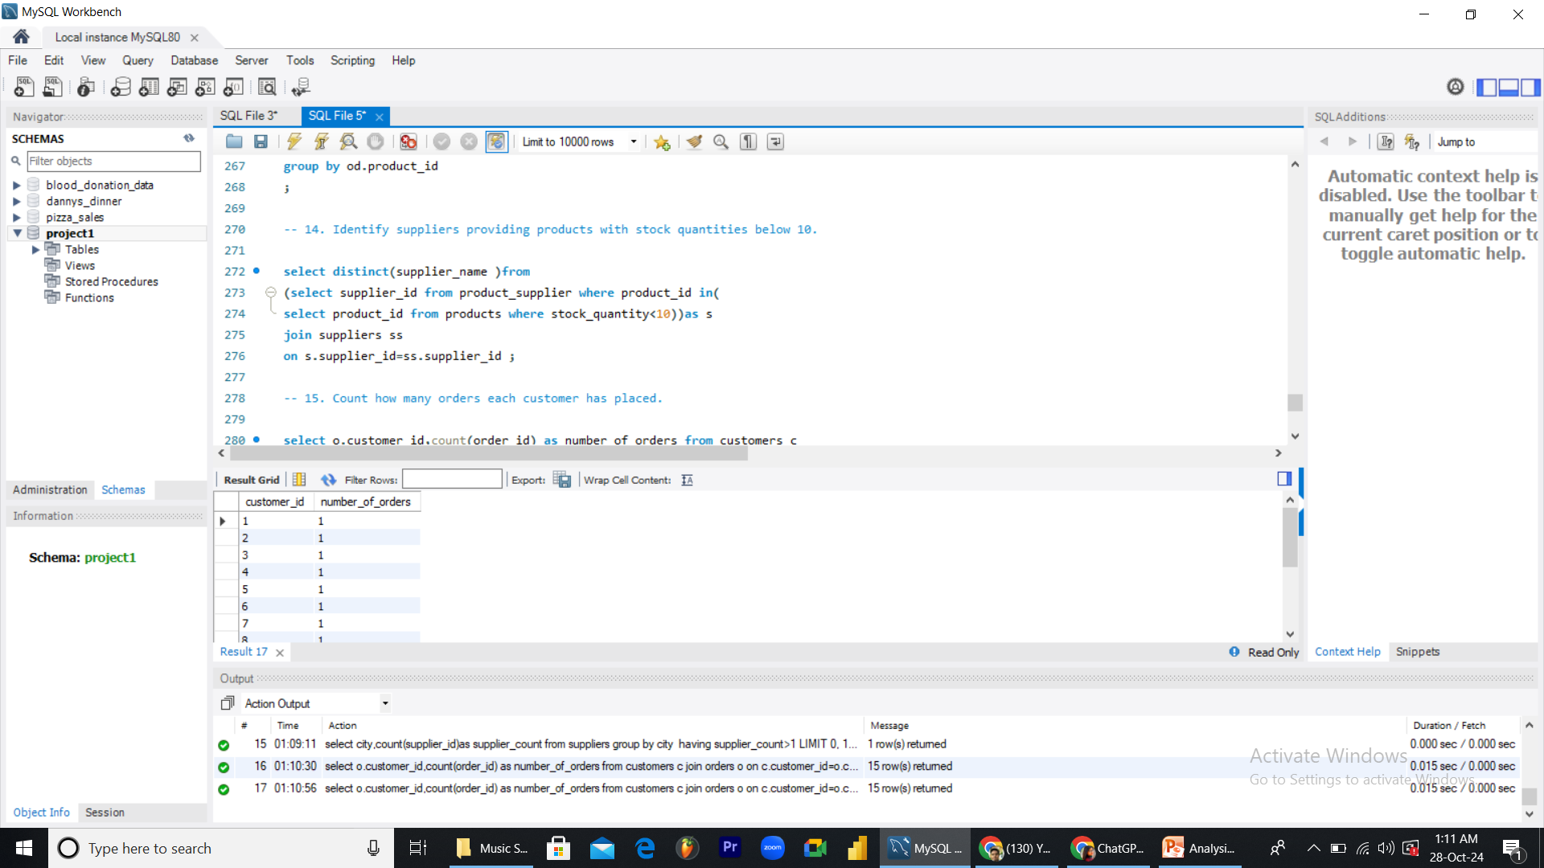
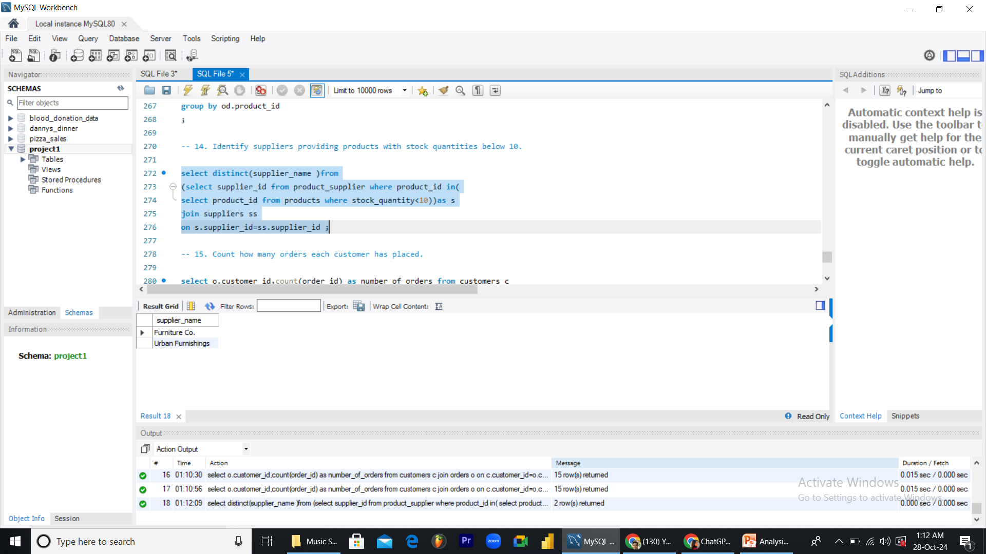
Analysis-Questions Answer
-- 14. Identify suppliers providing products with stock quantities below 10.

Slide 15


Analysis-Questions Answer
-- 15. Count how many orders each customer has placed.

Slide 16
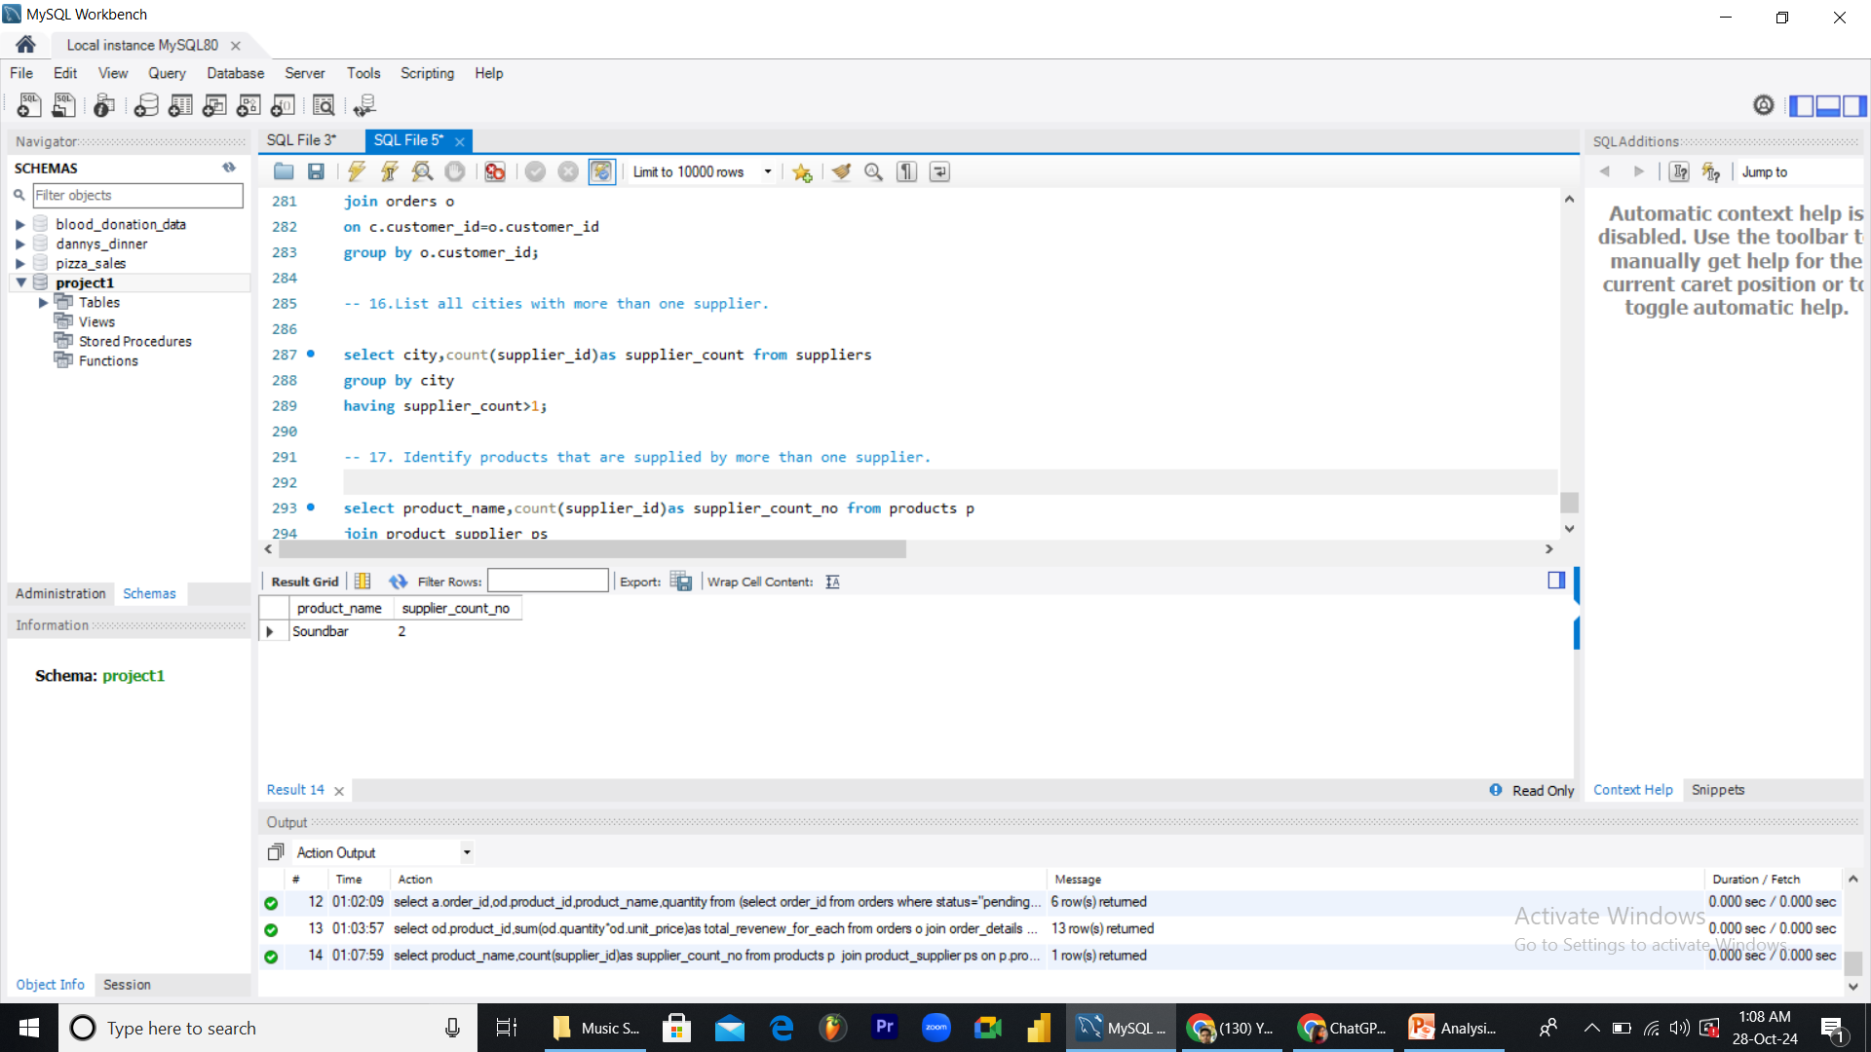
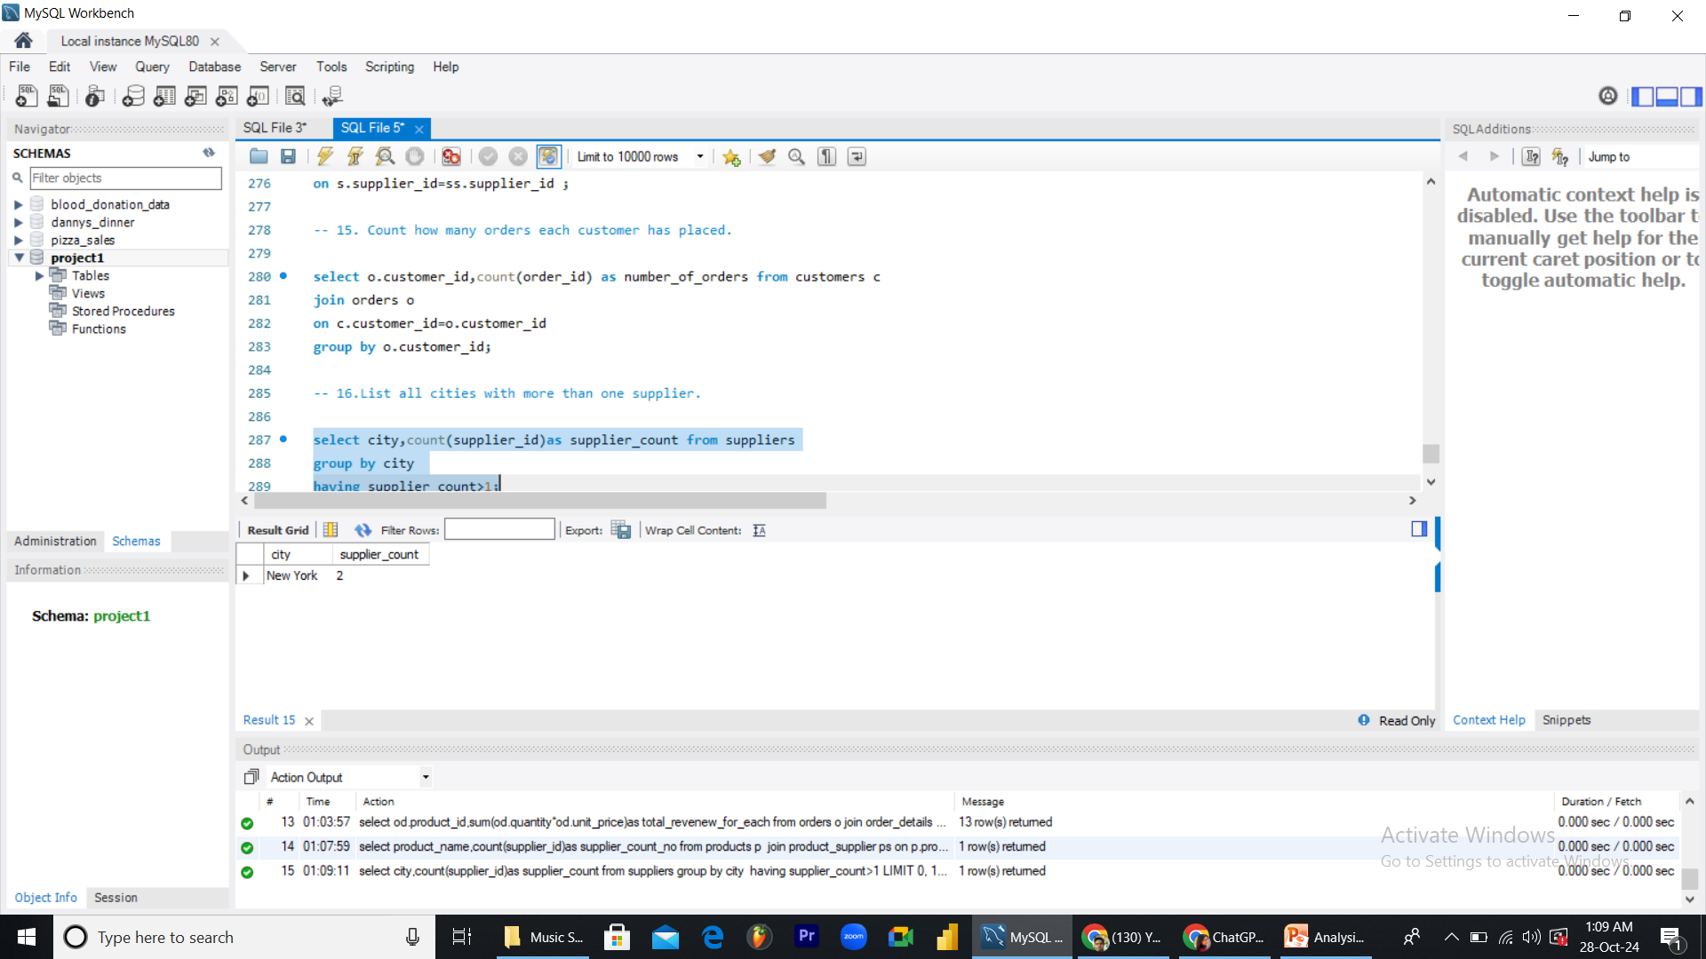
Analysis-Questions Answer
-- 16.List all cities with more than one supplier.

Slide 17

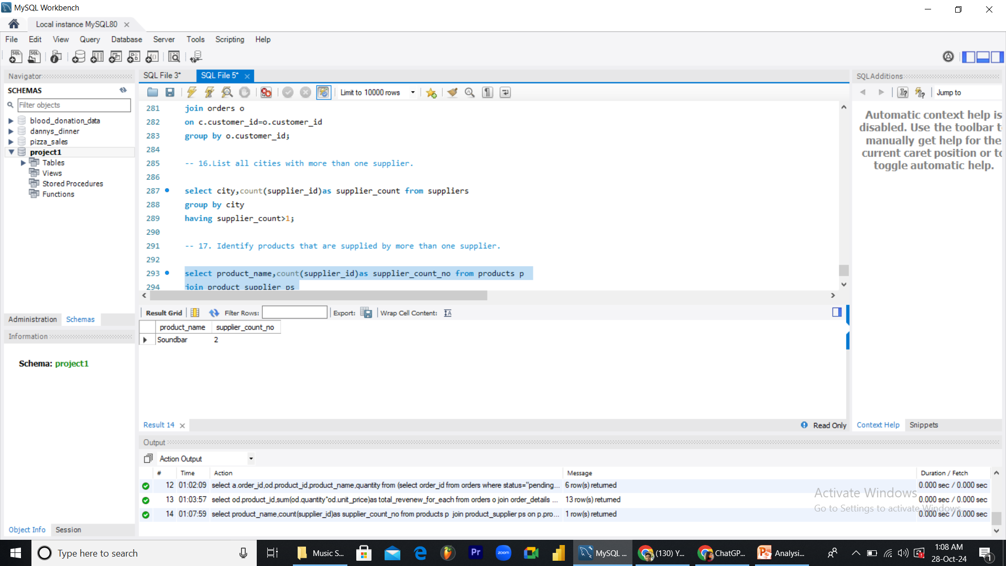
Analysis-Questions Answer
-- 17. Identify products that are supplied by more than one supplier.

